Slide 1

SCCM CLIENT Troubleshooting – Continued…
HTMD
Our Page:
https://www.anoopcnair.com/
https://howtomanagedevices.com/

Slide 2
Agenda
SCCM Client requirements
Do & Don’t
How? https://www.anoopcnair.com/sccm-logs-files/
Importance https://www.anoopcnair.com/improve-overall-health-windows-system-along-sccm-client-health/
Challenges https://www.anoopcnair.com/sccm-cb-ccmsetup-exit-code-collector-powershell-script/
Automation https://www.anoopcnair.com/fix-sccm-client-issues-automation/
WMI
Question?

Slide 3
Check WMI consistency: winmgmt /verifyrepository
Try to access instances under: wbemtest > root\ccm\invagt > enum classes > recursive > inventory action status > instances
Verify if services "DCOM Server Process Launcher" and "Distributed Transaction Coordinator" are running. If not, start them.
Permissions on WMI.
wmimgmt.msc> Wmicontrol> Properties> Security Local system should have full control on root\ccm and root\ccm\invagt
Try giving full control to everyone for these 2 location. Retry inventory cycle and check inventoryagent.log.
Permissions on DCOM.
Dcomcnfg> Component Services> Computers > My computer. And check:

Slide 4
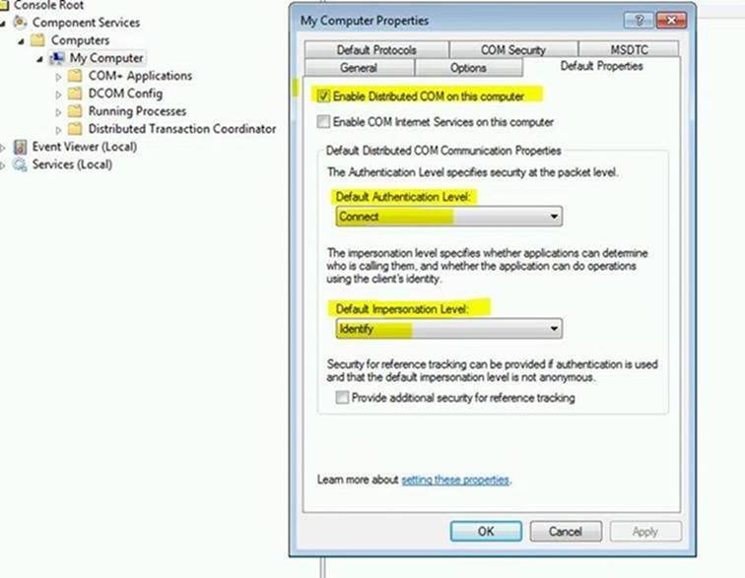
Dcomcnfg> Component Services> Computers > My computer. And check:
COM security tab>
Under Access permissions> Edit limits and give full control to user "everyone" if not given already. Edit default, System should have both local and remote access. Try adding and giving full control to everyone here.
Under Launch and Activation permissions> Edit limits> Everyone should have local launch and local activation. Try giving everyone user remote launch and remote activation too. Make this change in Edit default tab too.

Slide 5
Clients Fails Installation - MSXML6 "Failed to connect to server" Error 0x80080005
Go to start\run and type : msiexec /unregister.
Once done Go to services.msc and we should not see the Windows Installer service there.
Go to start\run and type : msiexec /regserver.
Once dome We should now see Windows Installer service under services.msc.
Go to start\run and type regsvr32 Msi.dll /u (this unregisters the msi.dll)
Go to start\run and type regsvr32 Msi.dll (this re-registers the msi.dll)
Go to start\run and type regsvr32 Msihnd.dll /u (this unregisters the msihnd.dll)
Go to start\run and type regsvr32 Msihnd.dll (this re-registers the msihnd.dll
After doing above steps, try to install client again, if still failed, please install the MSXML 6.0 manually.
Check DCOM

Slide 6
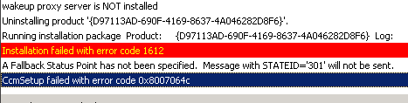
-
Looked for all and couldn't find a way to get rid of it. Then i search on HKLM on the machine for the client version (4.00.5931.0001)
I found a key (2 to be more specific) on for each installation version on the following path
HKEY_LOCAL_MACHINE\SOFTWARE\Microsoft\Windows\CurrentVersion\Installer\UserData\S-1-5-18\Products\
Only removed them and i was able to install client 2012 without any issues.

Slide 7
Error code: 0x80070641
First Check Windows Installer Services.
Re -register the Windows Installer by following method.
Click Start, click Run, type msiexec /Unregister
(check service -It must be gone after above command.)
Then type msiexec /regserver
-
Solving Error 1001 : The specified service has been marked for deletion
If you are creating Windows Services you may run into this annoying little error from time to time,
Error 1001. The specified service has been marked for deletion
At first I used to restart my machine to get rid of it, but there is a (much) simpler way. Simply closing the Services Manager (services.msc or the mmc.exe tool) will solve it.

Slide 8
SCCM MSI: Could not access network location %APPDATA%\
Resolution:- Check the registry of each *sob* clients that we're left out. Here's the registry: HKEY_USERS\S-1-5-18\Software\Microsoft\Windows\CurrentVersion\Explorer\User Shell Folders Look for "AppData" and change the value to " %USERPROFILE%\AppData\Roaming"
Failed to get certificate. Error: 0x80004005
1. When looking on the client in control panel I see it has no certificate and the connection type is unknown
2. CertificateMaintenance.log on the client throws several errorsè Failed to create certificate 80090020 CertificateMaintenance
3. ClientIDManagerStartup.log on the client also shows many errorsèRegTask: Failed to get certificate. Error: 0x80004005 ClientIDManagerStartup
Note:- Please take the backup of the key before deleting it from the client machine.
Resolution:- I located the MachineKeys directory on Windows 7 (C:\ProgramData\Microsoft\Crypto\RSA\MachineKeys) and removed the key that started with 19c5cf and the cert was able to be created. Repaired CCM on the client and it was reporting in no time. I believe it was an old cert on that machine from before I had SCCM configured correctly, thus it had to be cleared to function correctly.
-

